Slide 1
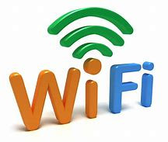
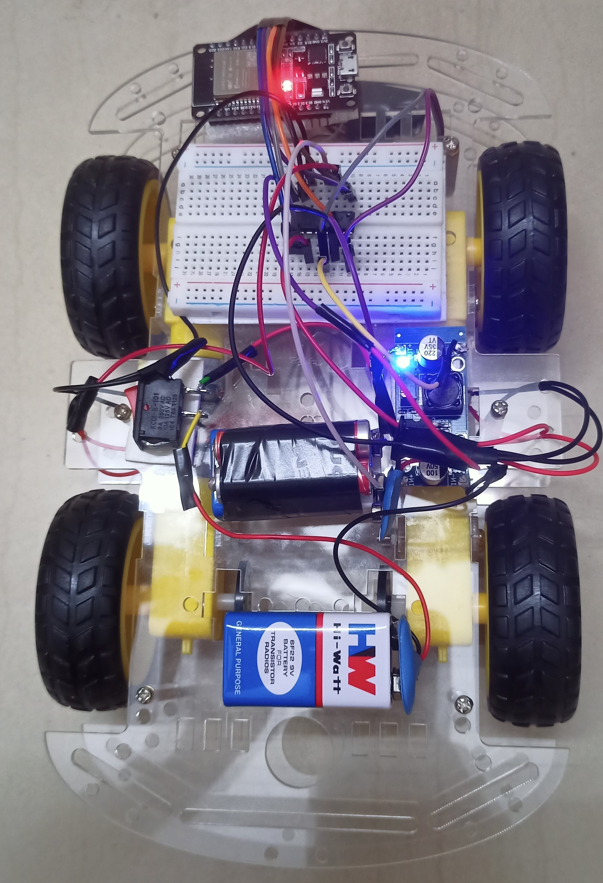
Wi-Fi Car
Professor: - Dr. Dastagiri Reddy
An Effort by: -
1- Amar Pratap Singh (2110509)
2- Anurag C Narboli (2110512)
3- Bharat Singh (2110301)

Slide 2
I
N
T
R
O
D
U
C
T
I
O
N
WIFI Controlled Car – Arduino Concept
“Cars are built employing a variety of transmission methods, But what about a car that can be controlled over WIFI.”
WIFI is the most promising technology right now, and developers are always working to improve it. This technology is prevalent today and will be for many years to come. WIFI with low power consumption has also been developed. So lets concentrate on this technology today. Creating a car that can be controlled via WIFI.

Slide 3
Required Components
1- ESP32 Microcontroller
2- LM2596 (Buck Converter)
3- L293D (Motor Driver)
4- Battery
5- Jumper Wires
6- 4 Motors
7- 4 Wheels
8- Car Chassis
9- Switch
10- Multimeter

Slide 4
Microcontrollers
Microcontrollers are everywhere around us, even when we drive our vehicles, on all computers we use including smartphones and tablets, or sometimes when making a cup of coffee on our coffee machines. With the rapid spreading of IoT technology, data is constantly being gathered, microcontrollers have become a huge part of the modern world with a lot of fields of application.

Slide 5
What is a Microcontroller ?
A microcontroller which is also called an MCU or Microcontroller Unit is a single Integrated Circuit (IC) that is usually used for a specific application and designed to implement certain specific tasks. This is a small computer based on a single metal-oxide-semiconductor (MOS) integrated circuit (IC) chip. A microcontroller contains one or more CPUs or processor cores with memory and programmable input/output peripherals attached to it. Program memory in the form of ferroelectric RAM, NOR flash, or OTP ROM is also often included on this chip, as well as a small amount of RAM along it.

Slide 6
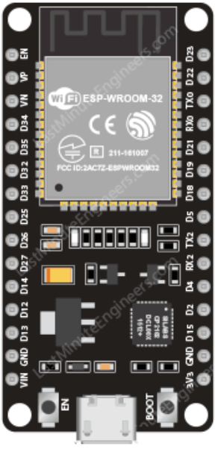
ESP32
The ESP32 is a series of low-cost and low-power System on a Chip (SoC) microcontrollers developed by Espressif that include Wi-Fi and Bluetooth wireless capabilities and dual-core processor.

Slide 7
ESP32 Specifications
Wi-Fi Capabilities: The ESP32 can easily connect to a Wi-Fi network to connect to the internet (station mode), or create its own Wi-Fi wireless network (access point mode) so other devices can connect to it, this is essential for IoT and Home Automation projects. we can have multiple devices communicating with each other using their Wi-Fi capabilities.

Slide 8
Bluetooth: the ESP32 supports Bluetooth classic and Bluetooth Low Energy (BLE) which is useful for a wide variety of IoT applications.
Processor: Tensilica Xtensa Dual-Core 32-bit LX6 microprocessor, running at 160 or 240 MHz
Memory: ROM: 448 KB (for booting and core functions)
SRAM: 520 KB (for data and instructions)
Low Power: ensures that you can still use ADC conversions, for example, during deep sleep.
Dual-core: most ESP32 are dual-core they come with 2 Xtensa 32-bit LX6 microprocessors: core 0 and core 1.

Slide 9
ESP32S Pinouts
GPIO Pins - General Purpose Input/Output Pins
ADC – Analog to Digital Converter
DAC – Digital to Analog Converter
GND – Ground
Vin – Input Voltage (5V Regulated supply)
3V – 3V Power Output

Slide 10
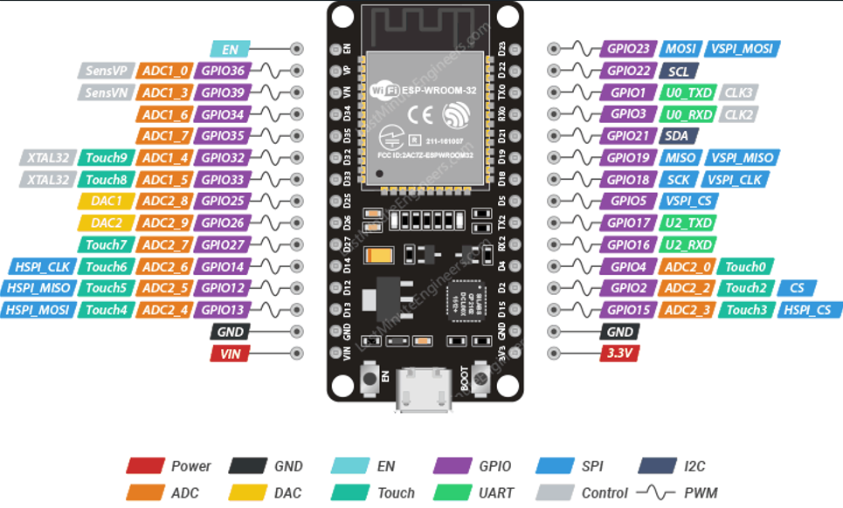

Slide 11
GPIO Pins
ESP32 development board has 25 GPIO pins which can be assigned to various functions programmatically. Each digital enabled GPIO can be configured to internal pull-up or pull-down, or set to high impedance.

Slide 12
Which ESP32 GPIOs are safe to use?
Because the ESP32 has many pins with specific functions, they may not be suitable for some projects. The following page shows which pins are safe to use and which pins require more attention before using them.

Slide 13
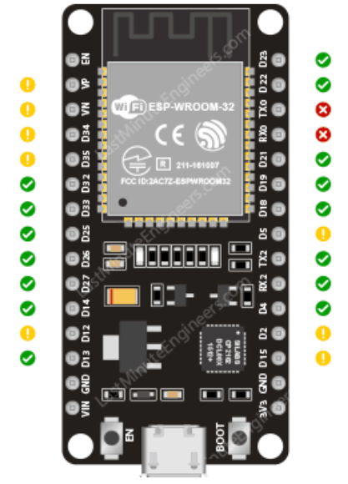
Pins which are safe to use

Slide 14
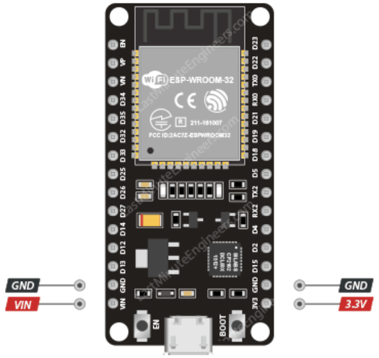
POWER PINS
There are two power pins viz. VIN pin & 3.3V pin. The VIN pin can be used to directly supply the ESP32 and its peripherals, regulated 5V can be given to the microcontroller. The 3.3V pin is the output of an on-board voltage regulator. This pin can be used to supply power to external components. GND is a ground pin of ESP32 development board.

Slide 15
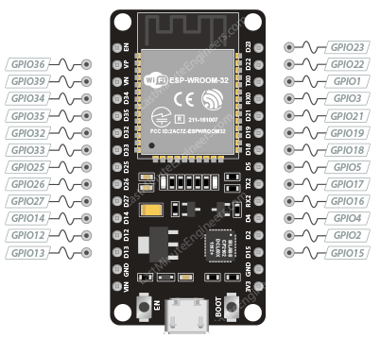
PWM PINS
The board has 25 channels (Nearly All GPIO pins) of PWM pins controlled by Pulse Width Modulation (PWM) controller. The PWM output can be used for driving digital motors and LEDs.

Slide 16
Arduino IDE
There’s an add-on for the Arduino IDE that allows to program the ESP32 using the Arduino IDE and its programming language.
Installing the ESP32 Board in Arduino IDE
Arduino IDE >File>Preferences
Additional Board Manager URLs:-
https://dl.espressif.com/dl/package_esp32_index.json

Slide 17
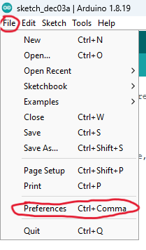
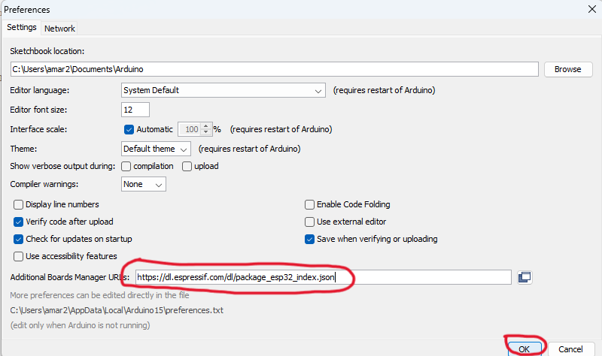

Slide 18
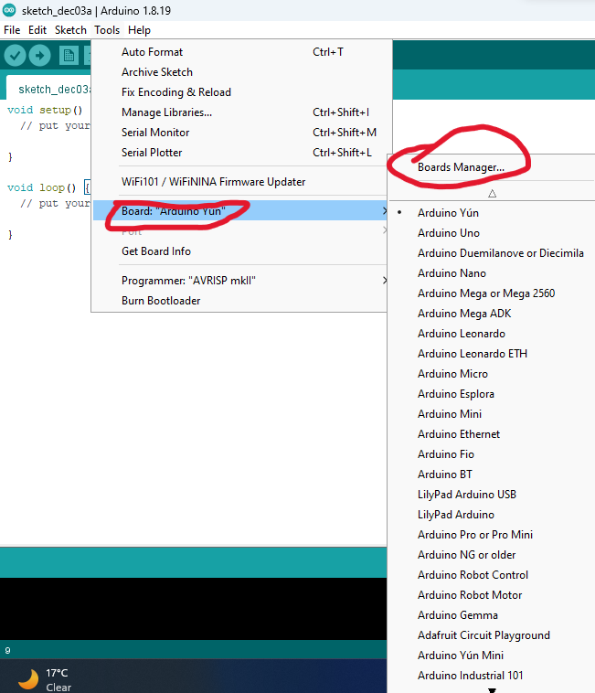
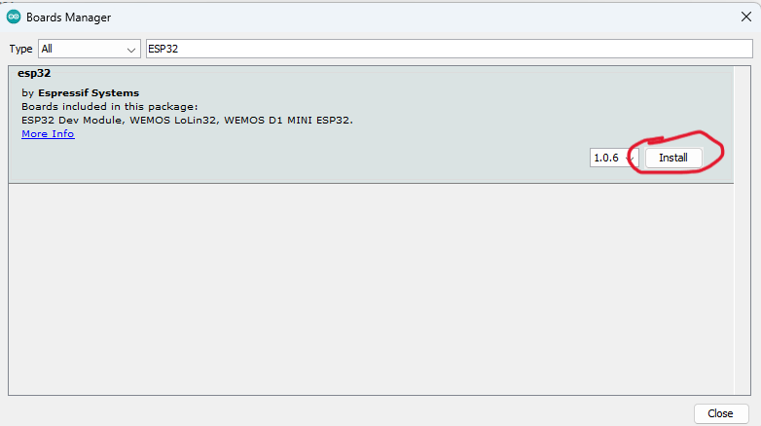
Installing the ESP32 board

Slide 19
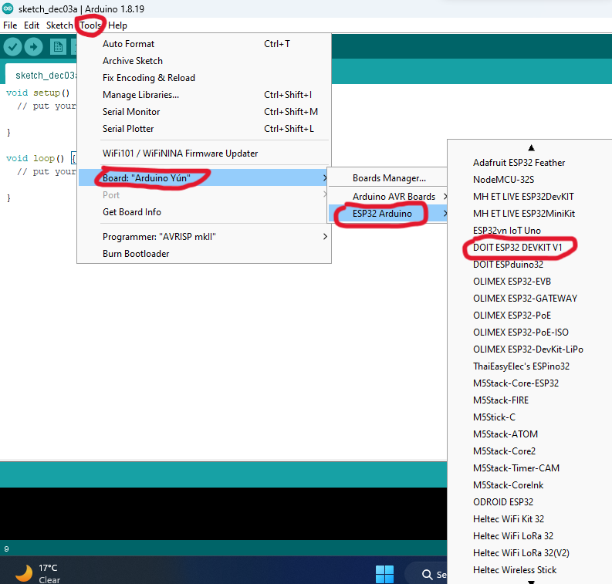
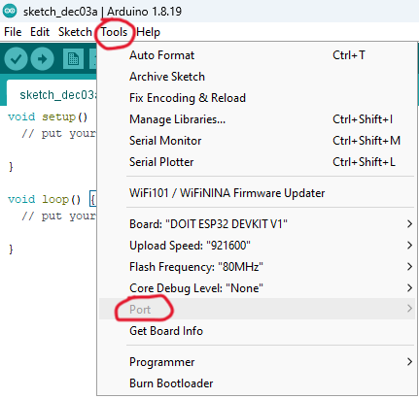
Selecting ESP32 Board

Slide 20
Including the following libraries is a must to use the IoT functions and features of ESP32
1-WiFi
2- ESPAsyncWebServer
3- analogWrite
4- ESPAsyncTCP (“ESPAsyncWebServer” library depends on “ESP32AsyncTCP” so “ESP32AsyncTCP” library also need to be installed.)

Slide 21
Programming Codes
//Including the following libraries is a must to use the IoT functions and features of esp32
#include "WiFi.h"
#include "ESPAsyncWebServer.h"
#include "analogWrite.h"
const char* ssid = "Wi-Fi Car"; // This will show up when mobile WIFI is on
const char* password = "EMTProject"; // change to more unique password
AsyncWebServer server(80); // These will start the webserver // If you don't know much, Ignore this line
// These pins are the Enable pins of the L293D motor driver which connects to esp32 gpio pins to implement the PWM function
int enable1_2 = 21; // choose the GPIO pin of esp32;
int enable3_4 = 22; // choose the GPIO pin of esp32;
// These pins are the input pins of l293d on the left side
int inp1 = 16; // Choose your GPIO pin of esp32 for the input 1
int inp2 = 17; // Choose your GPIO pin of esp32 for the input 2

Slide 22
// These pins are the input pins of l293d on the right side
int inp3 = 18; // Choose your GPIO pin of esp32 for the input 3
int inp4 = 19; // Choose your GPIO pin of esp32 for the input 4
int led = 2; // until now you must know what is the inbuilt led pin number of esp32.
void setup(){
pinMode(enable1_2, OUTPUT);
pinMode(enable3_4, OUTPUT);
// The inputs
pinMode(inp1, OUTPUT);
pinMode(inp2, OUTPUT);
pinMode(inp3, OUTPUT);
pinMode(inp4, OUTPUT);
pinMode(led, OUTPUT);

Slide 23
// We use the following function to run the bot at variable speed.
analogWrite(enable1_2, 255); // analog write "255" corresponds to digital write "1"
analogWrite(enable3_4, 255);
WiFi.softAP(ssid, password); // This sets your esp32's name as per above mentioned
IPAddress IP = WiFi.softAPIP();
// A bit of WEB DEV stuff
server.on("/control", HTTP_GET, [](AsyncWebServerRequest *request){
if(request->hasArg("up")){
// You have to develop the logic that, when the Button "up" on the webpage is pressed, Then the esp32 executes the following commands
// Refer to the this for the webpage photo
digitalWrite(inp1, HIGH);
digitalWrite(inp2, LOW);
digitalWrite(inp3, HIGH);
digitalWrite(inp4, LOW);
digitalWrite(led, HIGH);
}

Slide 24
if(request->hasArg("down")){
digitalWrite(inp1, LOW);
digitalWrite(inp2, HIGH);
digitalWrite(inp3, LOW);
digitalWrite(inp4, HIGH);
digitalWrite(led, HIGH);
}
if(request->hasArg("left")){
digitalWrite(inp1, HIGH);
digitalWrite(inp2, LOW);
digitalWrite(inp3, LOW);
digitalWrite(inp4, HIGH);
digitalWrite(led, HIGH);
}
if(request->hasArg("right")){
digitalWrite(inp1, LOW);
digitalWrite(inp2, HIGH);
digitalWrite(inp3, HIGH);
digitalWrite(inp4, LOW);
digitalWrite(led, HIGH);
}

Slide 25
if(request->hasArg("stop")){
// if '255' is the equivalent to digital '1', and '0' is eqvivalent to digial '0', We vary the pwm values to vary the speed of the motor
analogWrite(enable1_2, 0);
analogWrite(enable3_4, 0);
digitalWrite(inp1, LOW);
digitalWrite(inp2, LOW);
digitalWrite(inp3, LOW);
digitalWrite(inp4, LOW);
digitalWrite(led, LOW);
}
if(request->hasArg("start")){
analogWrite(enable1_2, 255 );
analogWrite(enable3_4, 255);
digitalWrite(led, HIGH);
}
request->send_P(200, "text/plain", "");
});
server.begin();
}
void loop(){ }

Slide 26
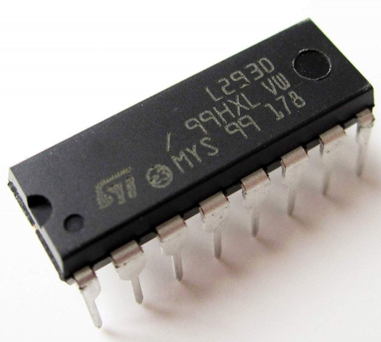
L293D (Motor Driver)
A motor driver is an integrated circuit chip that is usually used to control motors in autonomous robots. Motor driver act as an interface between Arduino and the motors. The most commonly used motor driver ICs are from the L293 series such as L293D, L293NE, etc. These ICs are designed to control 2 DC motors simultaneously. L293D consists of two H-bridge. H-bridge is the simplest circuit for controlling a low current-rated motor. We will be referring to the motor driver IC as L293D only. L293D has 16 pins.

Slide 27
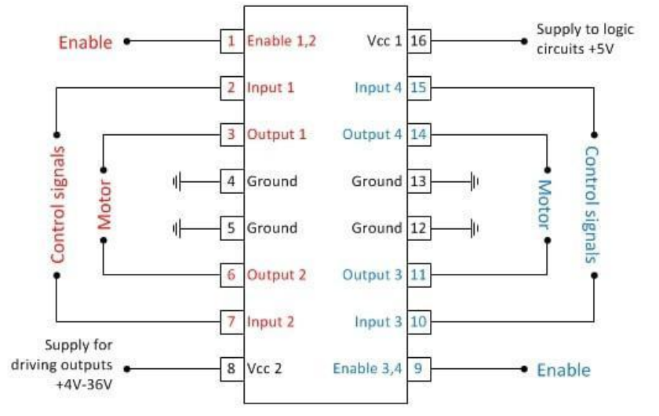

Slide 28
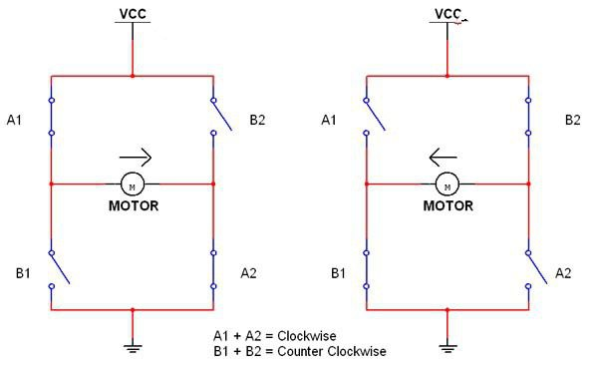
H Bridge
DIRECTION OF ROTATION OF MOTOR DEPENDS ON THE WAY WE CONNECT IT TO THE POWER

Slide 29
How to supply 5V to the L293D Motor Driver ?
5V supply is needed for the working of the motor Driver

Slide 30
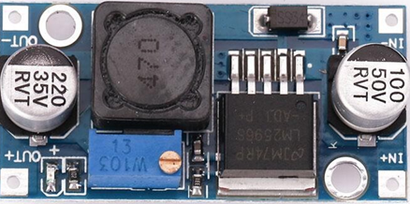
LM2596 (Buck Converter)
The LM2596 series of regulators are monolithic integrated circuits that provide all the active functions for a step-down (buck) switching regulator (DC-DC converter), capable of driving a 3-A load with excellent line and load regulation. These devices are available in fixed output voltages of 3.3 V, 5 V, 12 V, and an adjustable output version.

Slide 31
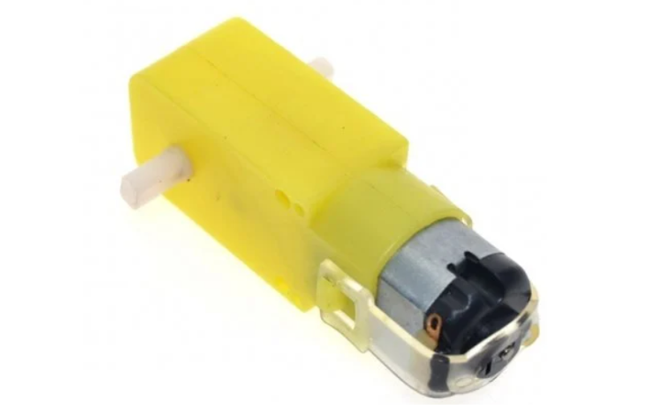
Motors
BO (Battery Operated) light weight DC geared motor which gives good torque and rpm at lower voltages. This motor can run at approximately 150 RPM when driven by a single Li-Ion cell. Great for battery operated light weight robots. A specific type of DC geared motors that can be operated through battery and that why known as Battery Operated (BO) motors. It is used for light weight applications mostly. Available in different torque and RPM

Slide 32
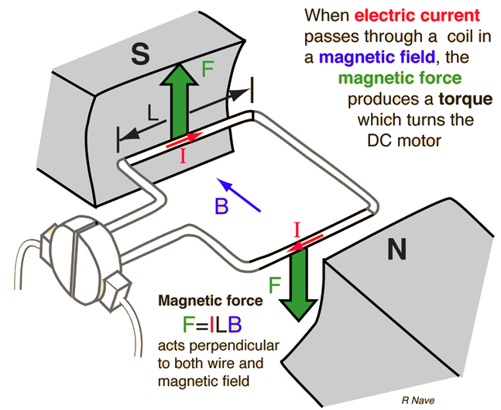
Working Principle of Motors

Slide 33
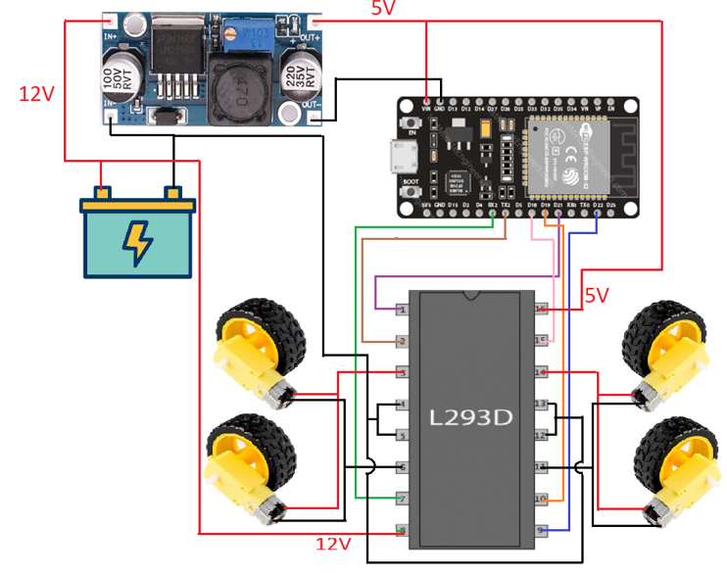
Wi-Fi Car Circuit Diagram

Slide 34
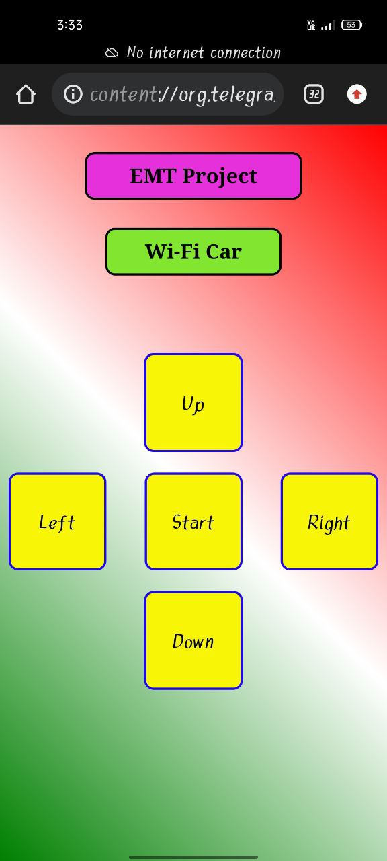
How to control the Wi-Fi Car ?
Controlling it through a website

Slide 35
Website Codes
<html>
<head>
<meta name="viewport" content="width=device-width">
</head>
<style>
#title{
margin: 26px 71px;
padding: 9px;
font-size: 19px;
border: 2px solid rgb(5, 5, 5);
border-radius: 9px;
background-color: rgb(229 48 219); }
#wifi{
margin: 15px 90px;
padding: 9px;
font-size: 19px;
border: 2px solid rgb(5, 5, 5);
border-radius: 9px;
background-color: rgb(130 229 48); }

Slide 36
.unselectable {
-webkit-touch-callout: none;
-webkit-user-select: none;
-khtml-user-select: none;
-moz-user-select: none;
-ms-user-select: none;
user-select: none;
border: 2px solid rgb(31, 6, 252);
border-radius: 9px;
background-color: rgb(249 245 7);
font-size: 20px;
}
.box:hover{
color: rgb(255, 102, 0);
background-color: rgb(0, 247, 255);
}
</style>
<body style="background-image: linear-gradient(45deg,green,white,red);">
<div style="text-align:center;">
<h1 id="title">EMT Project</h1>
</div>

Slide 37
<div style="text-align:center;">
<h1 id="wifi">Wi-Fi Car</h1>
</div></br></br></br>
<div style="text-align:center;">
<button class="unselectable box" ontouchstart="up()" ontouchend="off()" style="height:92px;width:92px;"> Up </button>
</div>
</br>
<div style="float:left;">
<button class="unselectable box" ontouchstart="left()" ontouchend="off()" style="height:91px;width:91px;"> Left </button>
</div>
<div style="float:right;">
<button class="unselectable box" ontouchstart="right()" ontouchend="off()" style="height:91px;width:91px;"> Right </button>
</div>
<div style="text-align:center;">
<button class="unselectable box" id="toggle" ontouchstart="toggle()" style="height:91px;width:91px;">Start
</button>
</div></br>

Slide 38
<div style="text-align:center;">
<button class="unselectable box" ontouchstart="down()" ontouchend="off()" style="height:92px;width:92px;"> Down </button>
<script>
var start = 1;
var url = "http://192.168.4.1/control?";
function up(){
fetch(url+"up")
}
function down(){
fetch(url+"down")
}
function left(){
fetch(url+"left")
}
function right(){
fetch(url+"right")
}

Slide 39
function off(){
fetch(url+"off")
}
function toggle(){
if(start==1){
start=0;
document.getElementById("toggle").innerHTML="Start"
fetch(url+"stop");
}else{
start=1; document.getElementById("toggle").innerHTML="Stop"
fetch(url+"start");
}
}
</script>
</body>
</html>

Slide 40
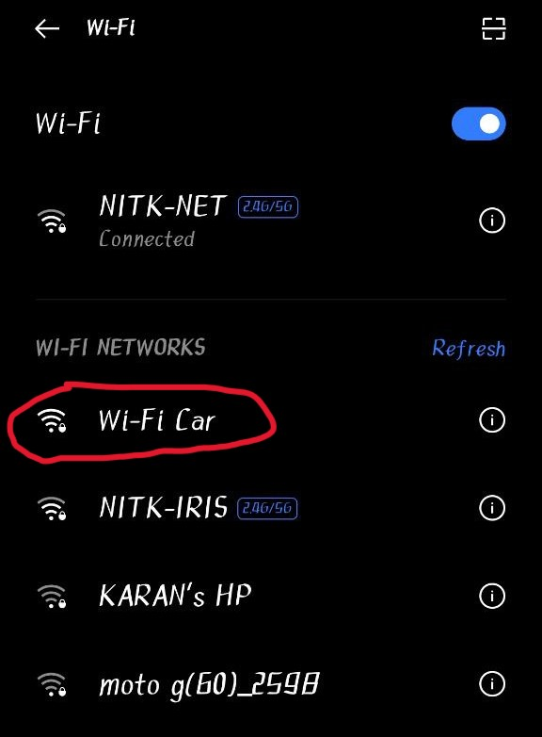
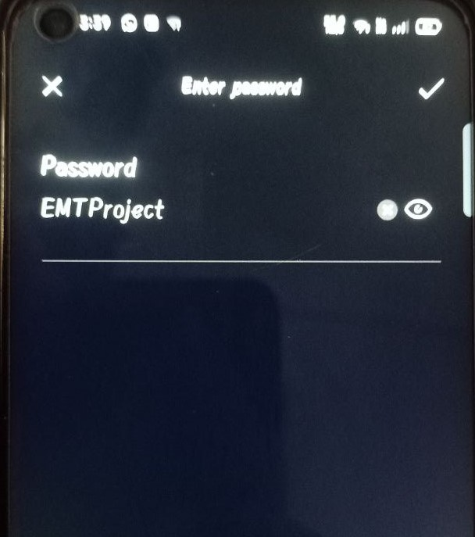
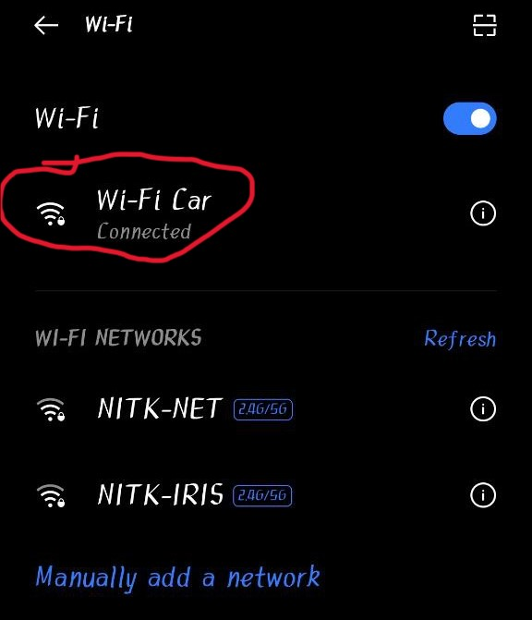
After turning on mobile Wi-Fi

Slide 41
Give the commands through the website to control the car

Slide 43
Power Supply
Control Terminal
ESP32 Microcontroller
LM2596 Voltage Regulator
L293D Motor Driver
Motor

Slide 44
Scope
It can be used as a monitoring and surveillance system.
It can be used for locating the survivors hidden inside the debris.
It can be used for parking assistance.
This system can be used in defiance applications for detecting landmines in war field and for bomb detections by mounting a metal detector sensor on it.

Slide 45
What extra can be done?
The Wi-Fi Car can be controlled through internet from anywhere siting in the world with the IP Address of the ESP32.

Slide 46
Learning Outcomes
When talking about the findings related to the topic, we selected for this group project we can categorize them under the following topics:
1. What are microcontrollers?
2. How to make proper use of the motor driver and Buck
Converter (LM2596) used in our model.
3. Due to a single default wire there may be a complete
failure of the setup.
4. Arduino Programming Languages.
5. HTML and CSS.
6. Learn from Testing failures.

Slide 47
Thank You

